Slide 2
A truly beautiful mind
Albert Einstein(14 March 1879 – 18 April 1955)

Slide 3
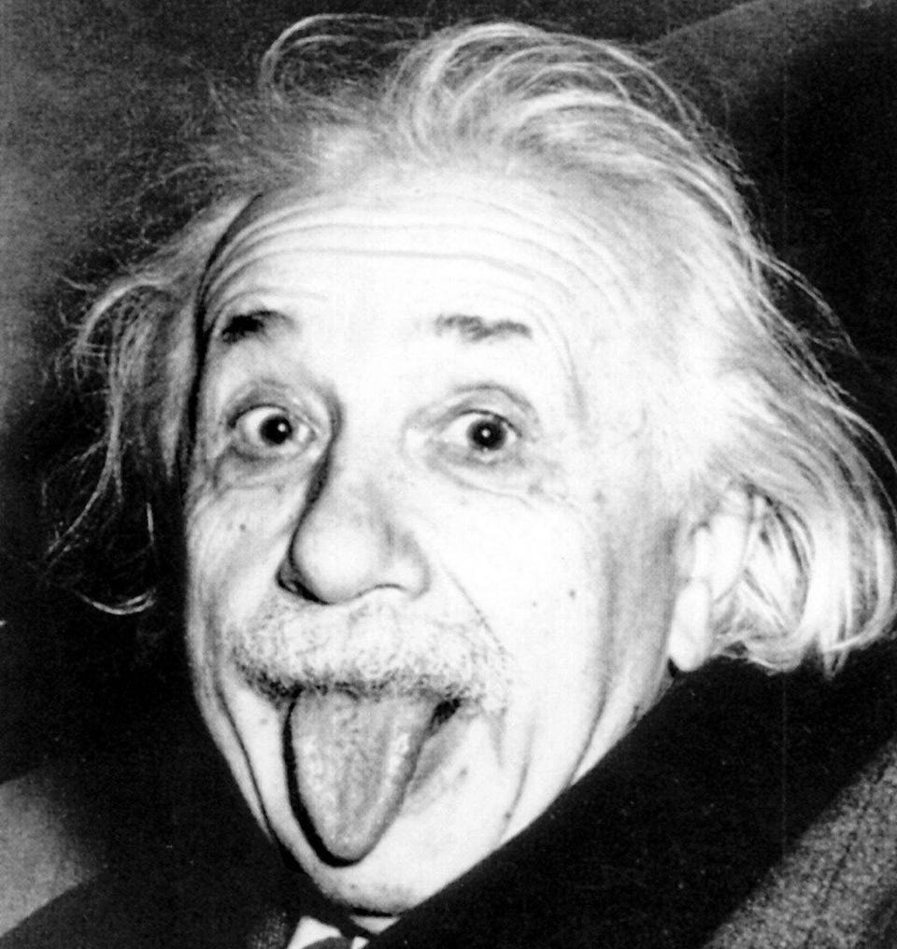
INTRODUCTION
Albert Einstein was a German-born theoretical physicist, widely acknowledged to be one of the greatest and most influential physicists of all time. Einstein is best known for developing the theory of relativity, but he also made important contributions to the development of the theory of quantum mechanics. Relativity and quantum mechanics are together the two pillars of modern physics. His mass–energy equivalence formula E = mc2, which arises from relativity theory, has been dubbed "the world's most famous equation".

Slide 4
TABLE OF CONTENTS
01
02
03
04
Childhood
Scientific
Revolutions
Personal Life
Death

Slide 5



01
CHILDHOOD
“I hate School”

Slide 6
The Young Albert
Born on 14th March 1879 in Germany had a lot of trouble with school. His mother thought of him as a freak also to her his head seemed to large.
He learnt to speak very late and when he did he uttered everything twice.
He had no friends and really loved mechanical toys and tried to figure out how they worked
When his new sister was born. It is said that Albert said looking at her
“Fine but where are her wheels”

Slide 7


The School
His family moved to Munich where he attended his high school he scored good marks in almost all subject.
At the age of 15 , Einstein was so stifled there that he left the school for good.
The previous year his parents moved to Milan and left there son with relatives.
After that Einstein got his wish to continue his education in German-speaking country Switzerland.
Einstein was highly gifted in Math’s and interested in science and after finishing school he studied in a university in Zurich.
His headmaster once told his father that what Einstein choose as a profession doesn’t matter as “he will never make a success at anything.” Albert hated the school regimentation.

Slide 8
02
Physics

Slide 9
Get a Job..
In 1900, Albert was 21 and university graduate and unemployed. He worked as assistant teacher. Gave private lessons
He finally secured a job in 1902, as a technical expert at a patent office in Berlin.
While he was supposed to be assessing other people’s invention , he was secretly developing his own ideas in secret .
Einstein is said to have jokingly called his desk drawer at work the “bureau of theoretical physics”

Slide 10
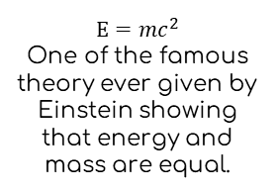
The three famous theories….
1905
1915
1905
The special theory of relativity which showed that time and distance were not absolute.
General theory of relativity was the theory of gravity showing it can curve space and time
$$E=mc^{2}$$
One of the famous theory ever given by Einstein showing that energy and mass are equal.

Slide 11
03
Personal Life

Slide 12
Get a Job..
In 1900, Albert was 21 and university graduate and unemployed. He worked as assistant teacher. Gave private lessons
He finally secured a job in 1902, as a technical expert at a patent office in Berlin.
While he was supposed to be assessing other people’s invention , he was secretly developing his own ideas in secret .
Einstein is said to have jokingly called his desk drawer at work the “bureau of theoretical physics”

Slide 13
01
The couple fell in love. Letters survive in which they put there love and affection. Albert had wanted to marry Mileva right after finishing his studies, but his mother was against it. She thought Mileva, who was three years older than her son, he was too old for him. The pair married in January 1903, and had two sons. But after few year marriage flattered. Mileva was becoming unhappy. After years of fighting.
The duo divorced in 1919 . Einstein married his cousin Elsa the same year.
His mother made him learn violin when he was 6. Einstein always had a taste for literature and art . In Zurich he also felt interest in a fellow student. Mileva Maric. Whom he found to be a clever creature. (Einstein had come to Zurich as it was the few universities where women could get degree)

Slide 14
04
The Endgame

Slide 15
PRACTICAL USES OF THIS SUBJECT
1915
1933
1919
1921
Publishes the paper on General Relativity.
Einstein leaves Germany because of rise of Nazi
The theory is confirmed by an solar eclipse
He received Nobel prize in physics.

Slide 16
World War 2 (waiting for the third)
?
?
When the Nazi came to power in Germany in 1933, He emigrated to the United States.
Five years later, the discovery of nuclear fission in berlin had American Physicists in an uproar.
A lot of scientist from Germany came to USA to safeguard from Germany getting a nuclear bomb.

Slide 17
01
02
Einstein wrote a letter to Franklin D. Roosevelt on 2nd August 1939, in which he warned: “A single bombed if this type….. Exploded in a port might very well destroy the port including the surrounding area.
President took it as a advise and bombed the two Japanese states of Hiroshima and Nagasaki in august 1945.

Slide 18
Into Depression
Albert Einstein deeply shaken by the extent of the destruction.
This time he wrote a public missive to the United Nations. In which he proposed the formation of a world government.
Unlike the letter to Roosevelt this one made no impact.
Over the next year Einstein got more into politics. Agitating for an end to the arms buildup and using
popularity to spread peace and democracy.

Slide 19

Einstein died in 1955 at the age of 76
Here is where your presentation begins

Slide 20
THANK YOU -Suprito Ghosh
Here is where your presentation begins

